Slide 1
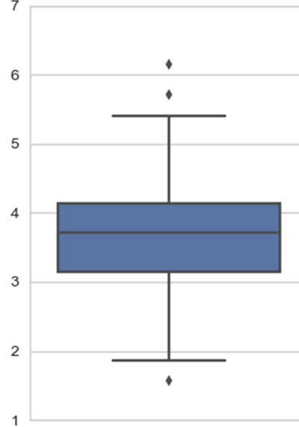
Title
How to read a Box Plot:
Box Plots are graphs that can represent responses to a
survey. Box Plots break down the data into quarters and
also show any outliers.
Scale
This box represents the middle 50% of respondents with
the black line indicating the median. 50% of all
respondents are above the median line and 50% are below.
The “whiskers” above and below the colored box
represent the top and bottom 25%
The “diamonds” indicate outliers, or respondents that
did not fit well with the rest.
Item Description

